Slide 1
Getting Started with Octopus Deploy
Sarah Lean
Senior Solutions Architect @Techielass

Slide 2
How to build infrastructure using Octopus

Slide 3
How to build infrastructure using Octopus
Take an existing application and automate the deployment to Microsoft Azure

Slide 4



Who am I?
Blog at www.techielass.com
@Techielass
Founder of the Glasgow Azure User Group
STEM Ambassador
17+ years in the IT industry
IT Pro

Slide 5
“DevOps is the union of people, process, and products to enable continuous delivery of value to our end users.” – Donovan Brown.

Slide 6
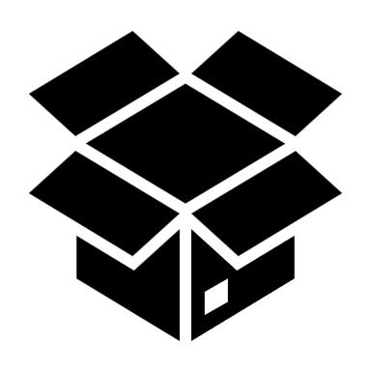
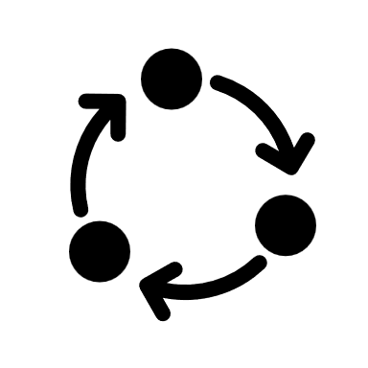





CI/CD Pipeline
Commit change
Trigger
build
Build
Notify
outcome
Test
Notify
outcome
Deliver build to environment
Deploy

Slide 7
What is Octopus Deploy?
DevOps tool helps you automate your processes
Release Management
Deployment Automation
Operations Runbooks
Notes:
With release management you can easily audit or see where you are with certain versions of your software. What version is your Dev environment run versus Production?
Octopus Deploy can help to simplify the deployment of your software. If you have a bunch of steps and things you need to do before each deployment, or even after deployment, Octopus Deploy can help you automate that.
It can also support deployment patterns such as rolling, blue/green, canary, multi-tenancy and beyond.
The runbooks capabilities gives you control over your infrastructure and applications. You can set up runbooks for routine maintenance or have them deploy or destroy infrastructure.

Slide 8
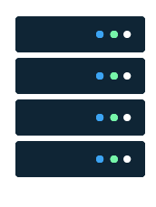
Running Octopus Deploy
Self hosted
Octopus Deploy Cloud

Slide 9

OctoPetShop
.NET Core solution:
Web front end
Product Service
Shopping Cart Service
Database

Slide 10
DEMO

Slide 11

What did we do?
Built out our Azure infrastructure with a runbook
Automated the deployment of the OctoPetShop

Slide 12


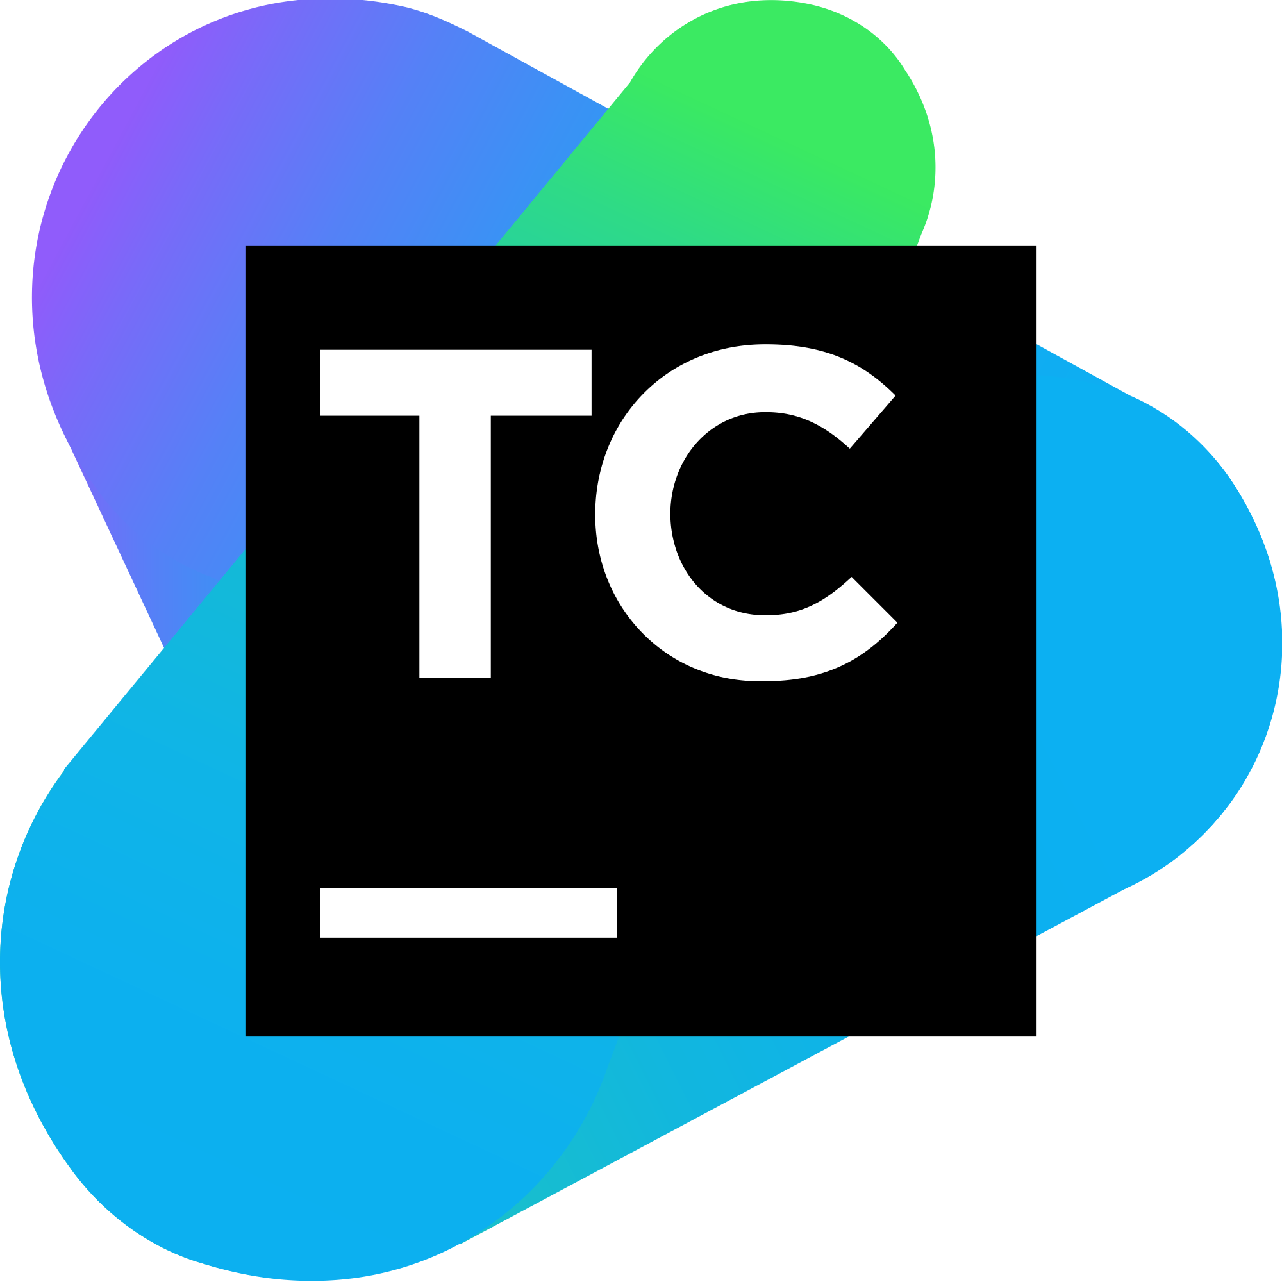




Build Server Integration
+ more
Notes:
AppVeyor
Azure DevOps & Team Foundation Server
Bamboo
BitBucket Pipelines
Continua CI
Github Actions
Jenkins
TeamCity
More

Slide 13
Why use separate CI and CD tools?

Slide 14
Demo resources
Sample code - https://github.com/OctopusSamples/OctoPetShop
Octopus Deploy Instance - https://webinar.octopus.app/app#/Spaces-222

Slide 15
What else can Octopus do?
Users, Teams, Permissions
Workers and Execution Containers
Tenants
Config as Code

Slide 16
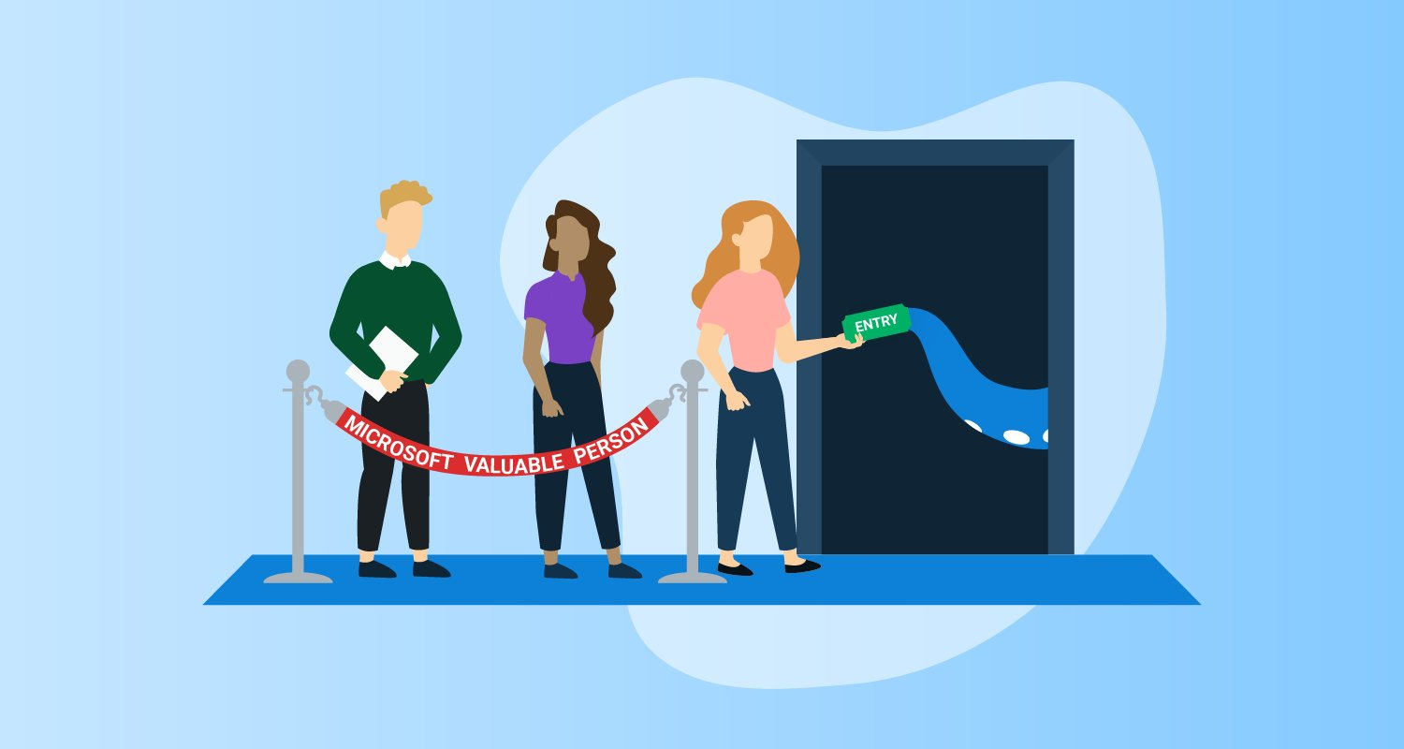
Microsoft MVPs = Free license
Reach out to MVP@octopus.com

Slide 17

Thank you! Resources: https://g.octopushq.com/DDOG
Sarah Lean
Senior Solutions Architect
@Techielass
www.techielass.com

